Slide 1








Leadership and Management Roadmap
Building FutureReady Leadership for Lasting Impact
Clear leadership goals
Leadership development
Role modeling
Inspiring and guiding the team with clear objectives involves setting a vision that motivates and energizes them, ensuring everyone understands their roles and responsibilities.
The continuous and dedicated development of leadership skills is essential for personal and professional success.
Effective leaders set positive examples by demonstrating integrity, commitment, and empathy in all aspects of their roles.

Slide 2


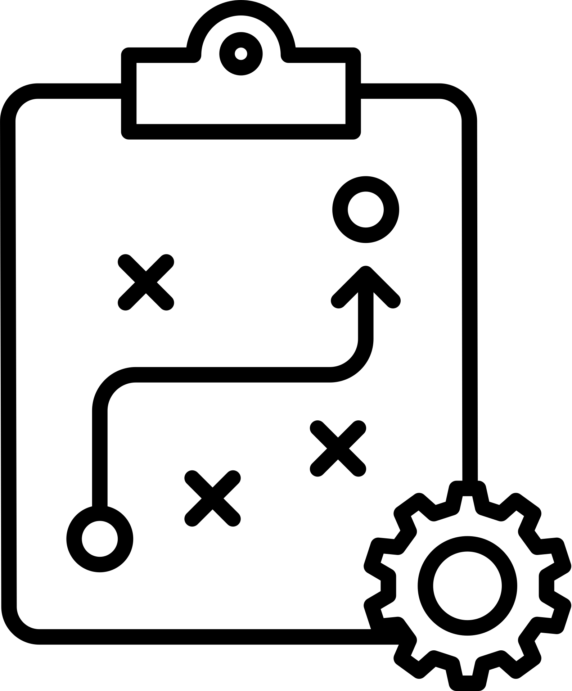



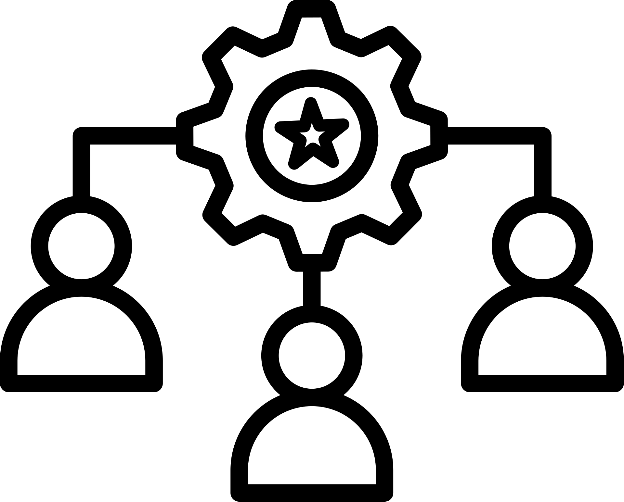
Strategic Management
Strategic planning
Risk management
Aligning plans with the overall organizational vision and mission.
Effectively managing risks is essential to maintaining stability in any organization or system.
Performance monitoring
Resource allocation
Tracking progress by utilizing Key Performance Indicators (KPIs) is an essential practice for any organization.
Effectively optimizing resources requires strategic planning and careful allocation to ensure that all available assets are utilized to their fullest potential.

Slide 3



Foster creativity
Encouraging new and innovative ideas.
Encourage experimentation
Driving Innovation
Supporting testing of new ideas.
Process improvement
Enhancing operational efficiency.
Idea incubation
Developing ideas into solutions.
Technology adoption
Leveraging technology for productivity.

Slide 4
Building Strong Teams
Talent development
Collaboration culture
Employee engagement
Growing team members’ skills.
Promoting teamwork and cooperation.
Boosting motivation and involvement.
Conflict management
Motivation programs
Diversity and inclusion
Resolving conflicts constructively.
Implementing incentives and rewards.
Valuing diverse perspectives.

Slide 5


Communication Excellence
Transparent communication
Feedback loops
Conflict resolution
Ensuring openness and clarity in communication is vital for building trust and fostering strong relationships.
Maintaining open and active feedback channels is essential for fostering communication and collaboration within any organization.
Effectively handling disputes requires a clear understanding of the issues involved, open communication between all parties.

Slide 6





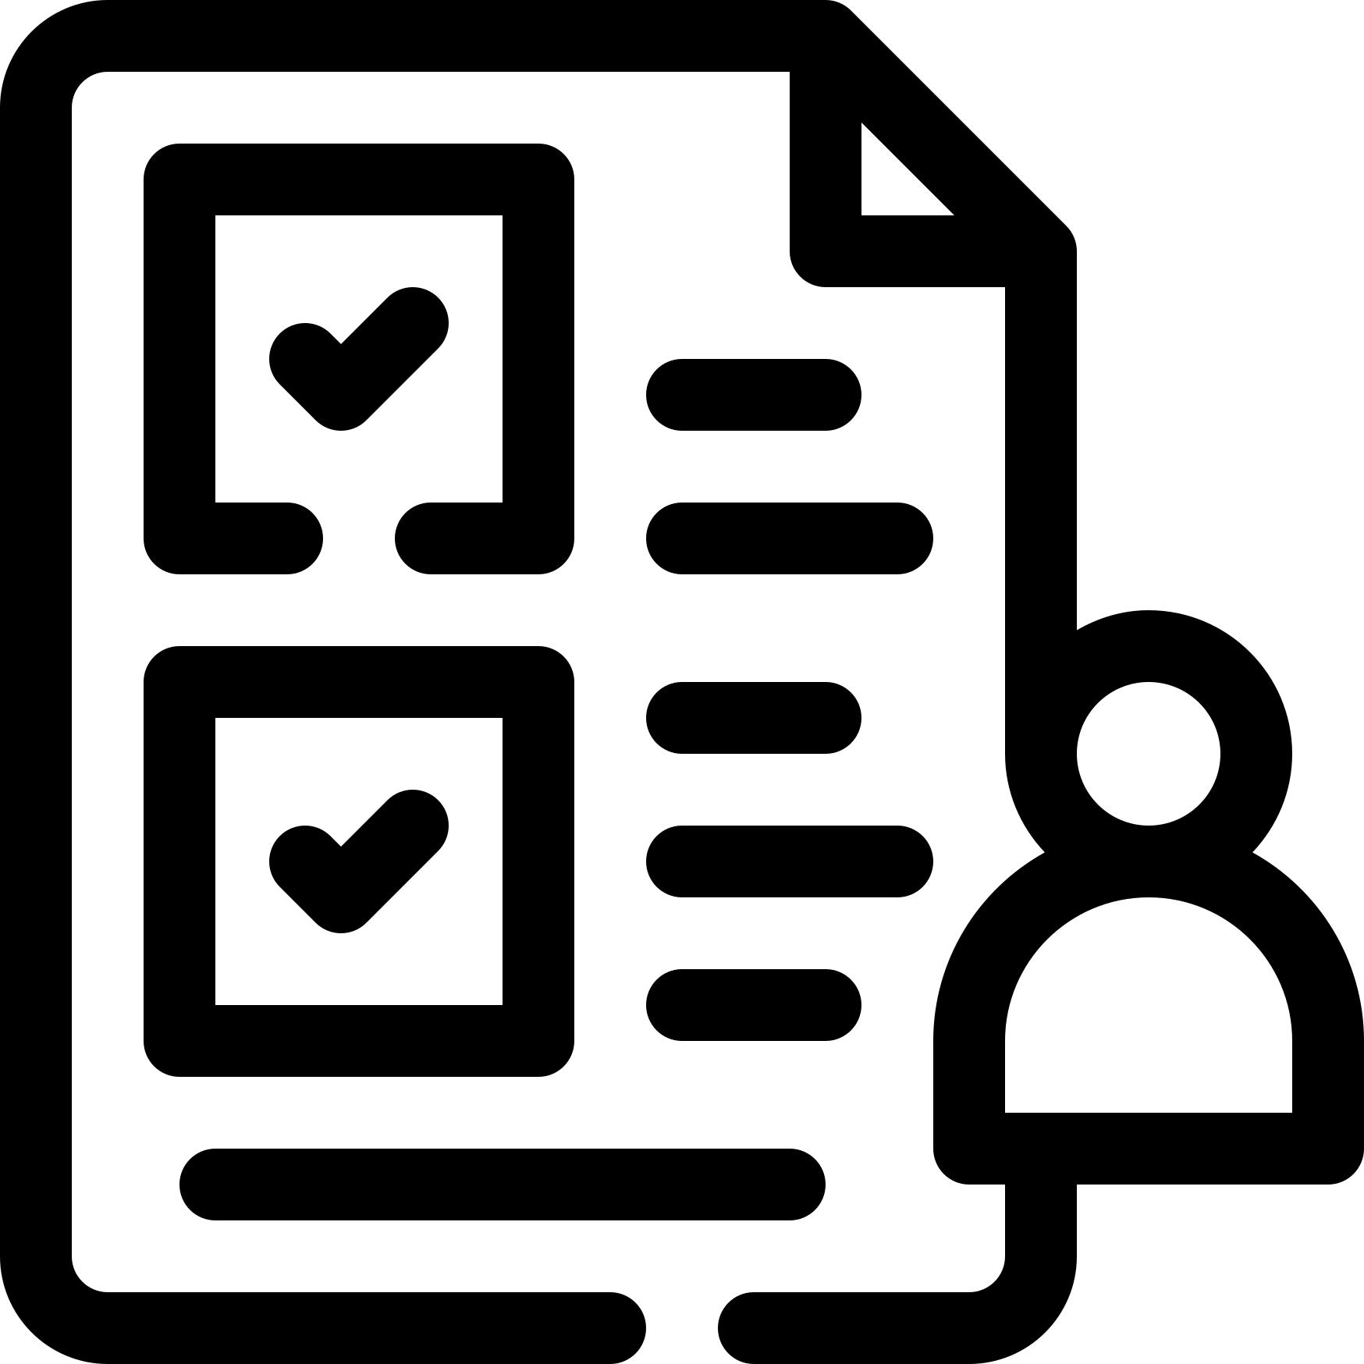

Sustainable Practices in Management
Transparent communication
Ethical standards
Compliance
Responsible leadership
Integrating sustainability into management practices is essential for long-term success.
Upholding integrity across all operations is essential for maintaining trust and ensuring ethical practices.
Adhering to established laws and industry norms is essential for maintaining compliance.
Leading with a strong commitment to social responsibility.

Slide 7


Measuring Leadership Impact
Leadership KPIs
Employee satisfaction
Continuous improvement
Exploring various methods for tracking leadership effectiveness in organizations.
Measuring staff happiness and retention is crucial for understanding the overall health of an organization.
Utilizing data to monitor and enhance ongoing progress consistently.

Slide 8



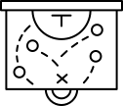
Leadership Training and Development
Skill enhancement
Mentorship programs
Leadership pipeline
Coaching culture
Offering comprehensive leadership training programs.
Guiding the leaders of tomorrow towards a brighter future.
Preparing future successors for their roles.
Encouraging and fostering a culture of coaching across various teams within the organization.

Slide 9


Change Management
Change readiness
Communication during change
Support systems
Resistance management
Preparing teams effectively for change involves clear communication
Providing updates in a transparent and open manner.
Offering all the necessary resources and support.
Addressing resistance effectively involves understanding the underlying causes of pushback

Slide 10




Future Leadership Vision
Innovative leadership models
Global trends
Sustained organizational growth
Exploring and adopting new leadership approaches can significantly enhance organizational effectiveness and foster a more dynamic work environment.
Incorporating a broad range of worldwide best practices is essential to ensure both efficiency and effectiveness in any operation. By examining and adapting strategies.
Ensuring long-term growth and adaptability requires not only strategic planning but also a commitment to continuous innovation.

